Slide 1
CARDIOVASCULAR RISK PREDICTION
CAPSTONE PROJECT
Presented By:
Sadda Balaji
GITAM University (Bengaluru)
CSE (AIML)

Slide 2
OUTLINE
Problem Statement
Proposed System/Solution
System Development Approach
Algorithm & Deployment
Result
Conclusion
Future Scope
References

Slide 3
Problem Statement
The classification goal is to predict whether the patient has a 10-year risk of future coronary heart disease (CHD). The dataset provides the patient’s information. It includes over 4,000 records and 15 attributes. Each attribute is a potential risk factor. There are both demographic, behavioural, and medical risk factors.

Slide 4
Proposed Solution
Creating a system is one of the goals of the proposed project. The goal of the suggested system is to provide proactive healthcare management by attempting to properly measure the prevalence of cardiovascular heart disease (CHD) across certain time periods. In order to accurately forecast CHD incidence patterns, this attempt involves utilizing the power of data analytics and machine learning approaches. The answer will consist of many elements, including:
Data Collection:
Data was collected from a CSV file named "data_cardiovascular_risk.csv". This dataset likely contains various features related to cardiovascular health and a target variable indicating the risk of developing coronary heart disease (CHD) within the next ten years.
Data Preprocessing:
Initial exploration of the data was conducted, including checking for missing values, visualizing data distributions, and handling missing values by dropping rows with missing values.
Feature engineering was performed by creating new columns such as 'Hypertension' and 'diabetes_grade' based on existing features.
Imbalanced data was handled using techniques like SMOTE and undersampling.
The data was split into training and testing sets, and features were scaled using StandardScaler.
Machine Learning Algorithm:
Logistic Regression algorithm was chosen for classification.
The logistic regression model was trained on the preprocessed data.
Deployment:
There is no explicit deployment step in the provided script. Deployment typically involves integrating the trained model into a production environment where it can be used to make predictions on new data.
Evaluation:
The model's performance was evaluated using various metrics such as accuracy, confusion matrix, ROC AUC score, and classification report on both the training and testing sets.

Slide 5
System Approach
The "System Approach" segment outlines the holistic strategy and methodology for constructing and deploying the Coronary Heart Disease (CHD) prediction system. The suggested structure for this section includes:
System requirements:-
The model development for coronary heart disease (CHD) risk prediction is supported on Windows, macOS, or Linux operating systems. Python version 3.x is essential for programming, while a multi-core processor ensures efficient computation during model training and deployment. These requirements offer flexibility and accessibility for users across different platforms, facilitating the development and utilization of the CHD risk prediction model.
Library required to build the model
The main libraries required to build the model for coronary heart disease (CHD) risk prediction include Pandas, NumPy, Matplotlib, Seaborn, and scikit-learn. These libraries provide essential functionalities for data manipulation, analysis, visualization, and machine learning algorithms necessary for constructing and evaluating the predictive model.

Slide 6
Algorithm & Deployment
In the Algorithm section, describe the machine learning algorithm chosen for predicting bike counts. Here's an example structure for this section:
Algorithm Selection:
The algorithm used for CHD risk prediction is logistic regression, which is well-suited for problems involving binary classification. Logistic regression is simpler, easier to understand, and more effective than time-series models since it is primarily meant for categorization. It is a reasonable option for CHD risk prediction since it fits the problem description and data properties well.
Data Input:
The algorithm uses a combination of clinical, demographic, and lifestyle factors to predict the risk of coronary heart disease (CHD). In addition to medication usage, they include age, gender, blood pressure, cholesterol, smoking, diabetes, and the frequency of hypertension. By accounting for so many variables, the algorithm provides people with comprehensive insights about their risk of CHD.
Training Process:
The algorithm is trained by changing its parameters based on historical data in order to minimize prediction errors. In addition to the corresponding CHD risk labels, it learns from features including blood pressure, cholesterol, age, gender, and lifestyle decisions. Through coefficient optimization, the process establishes a decision boundary that separates groups at high and low risk. Regularization and gradient descent are two techniques that may be applied to model optimization.
Prediction Process:
The trained algorithm makes predictions by using the patterns it has discovered from historical data to fresh observations. It uses real-time data inputs to extract attributes including medicine intake, smoking status, diabetes status, blood pressure, cholesterol, and age and gender. Using the logistic regression model, these inputs are utilized to determine if an individual has a low or high risk of coronary heart disease (CHD). The technique uses a preset threshold probability (often 0.5 for binary classification) to estimate an individual's risk level as either low or high. With the use of the prediction approach, those who could benefit from closer monitoring or preventative care for cardiovascular health can be quickly recognized.

Slide 7
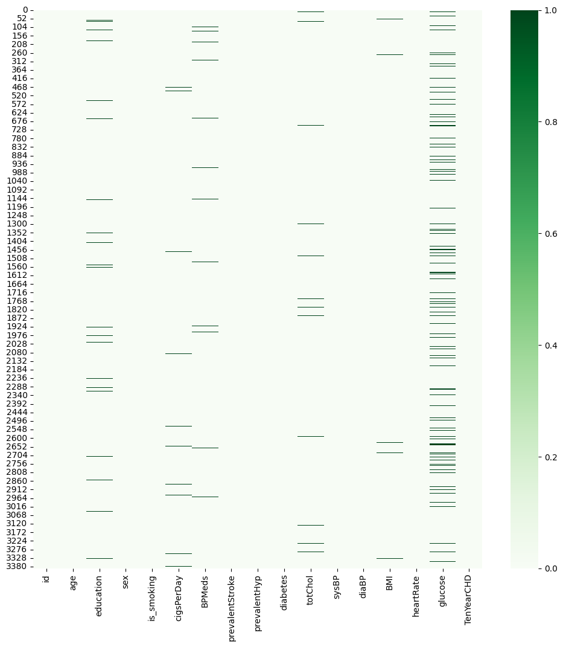
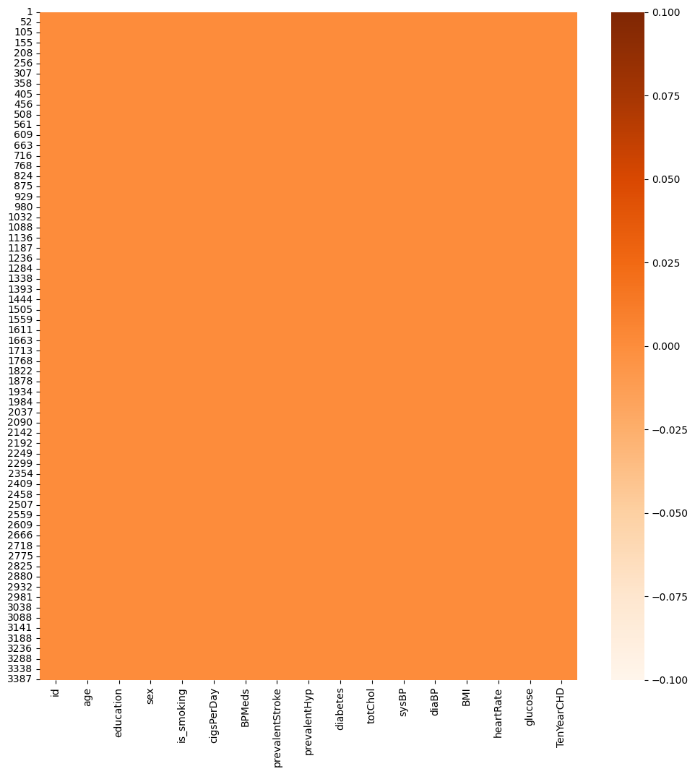
Visualization of Missing Values in the Dataset

Slide 8
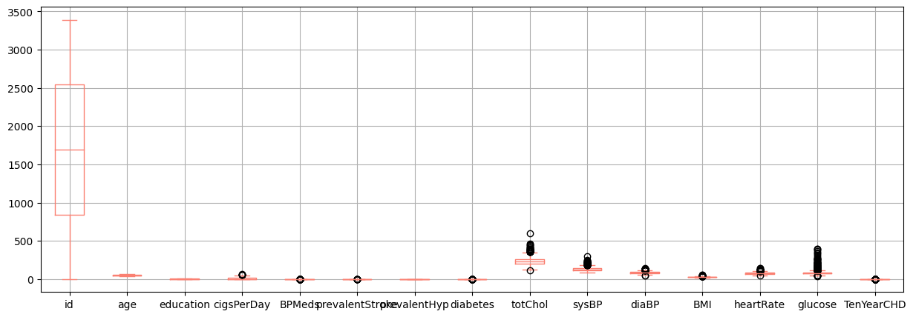
Boxplot Visualization of Dataset Distribution

Slide 9
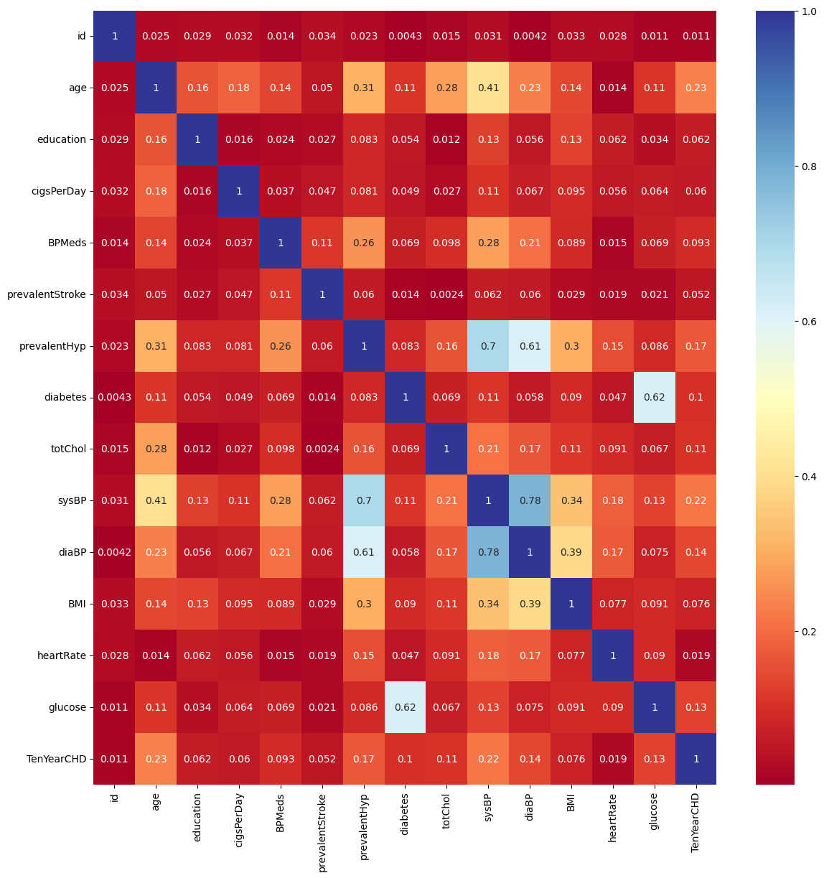
Heatmap of Feature Correlation

Slide 10
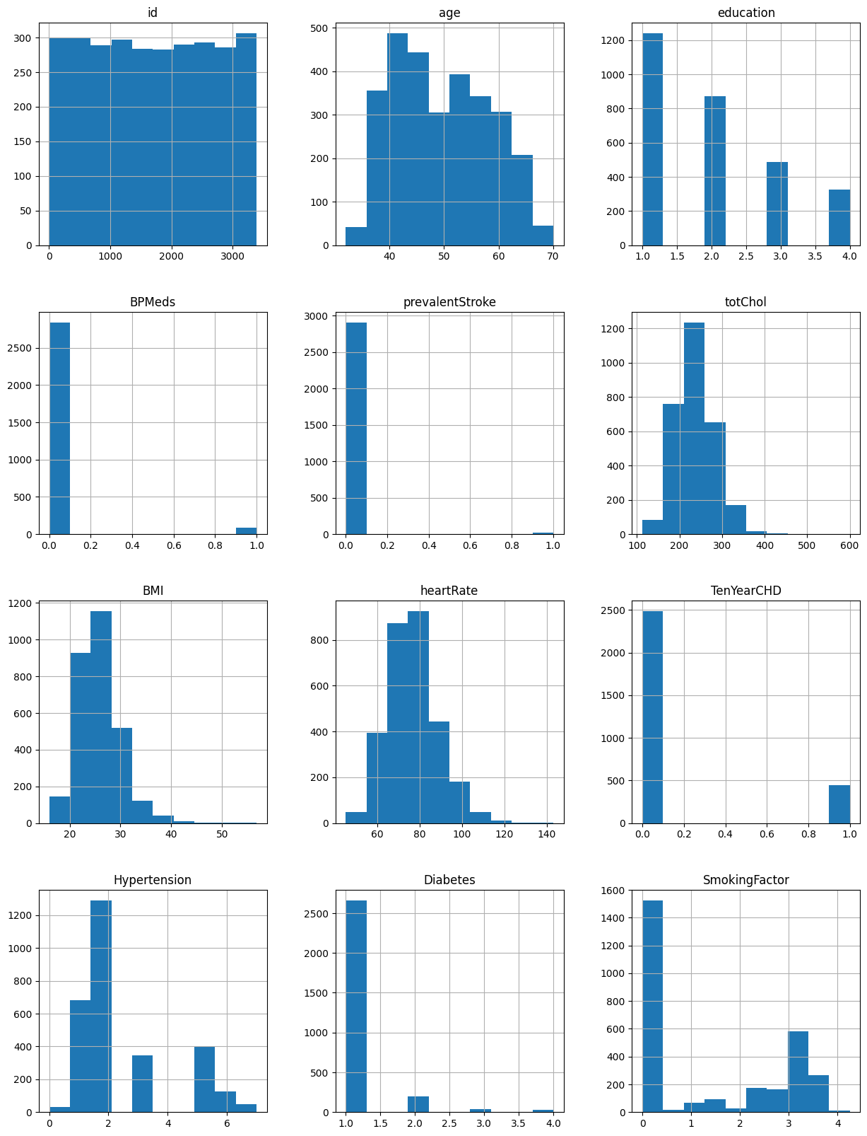
Distribution of data across different fields

Slide 11
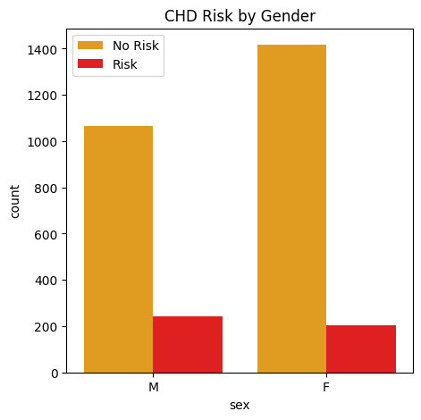
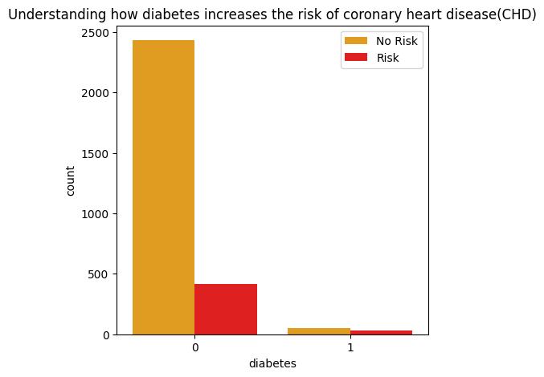
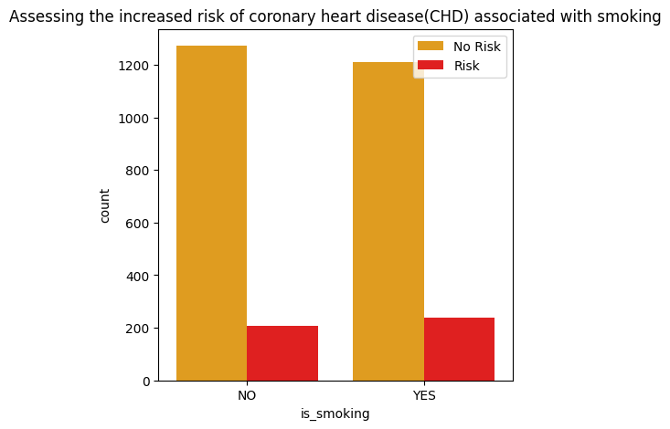
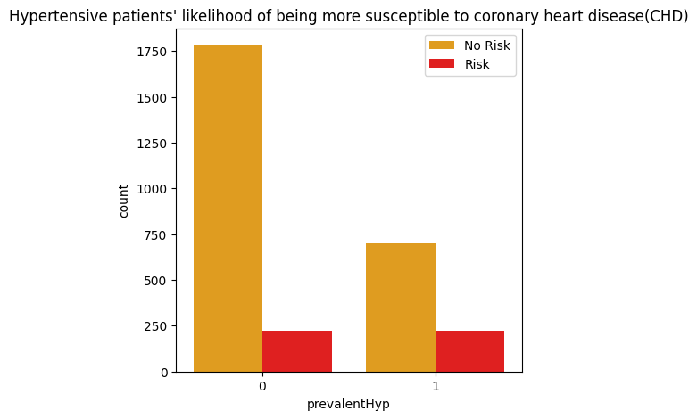

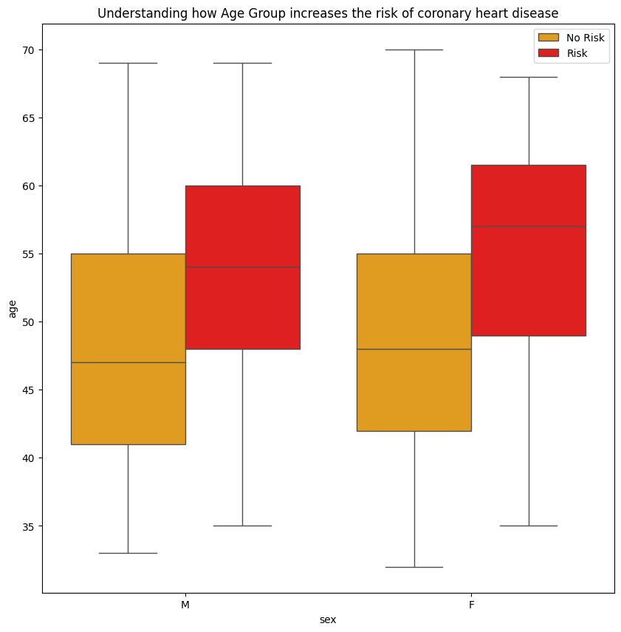
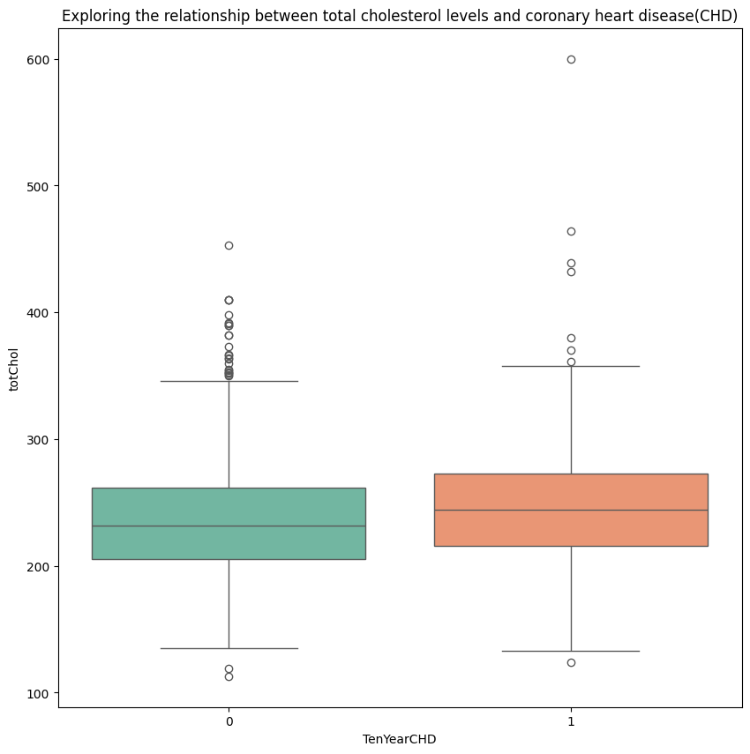
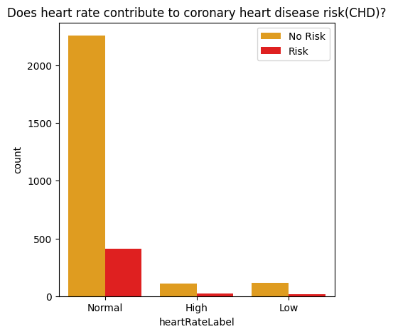
CHD Risk Analysis by Different Fields

Slide 12
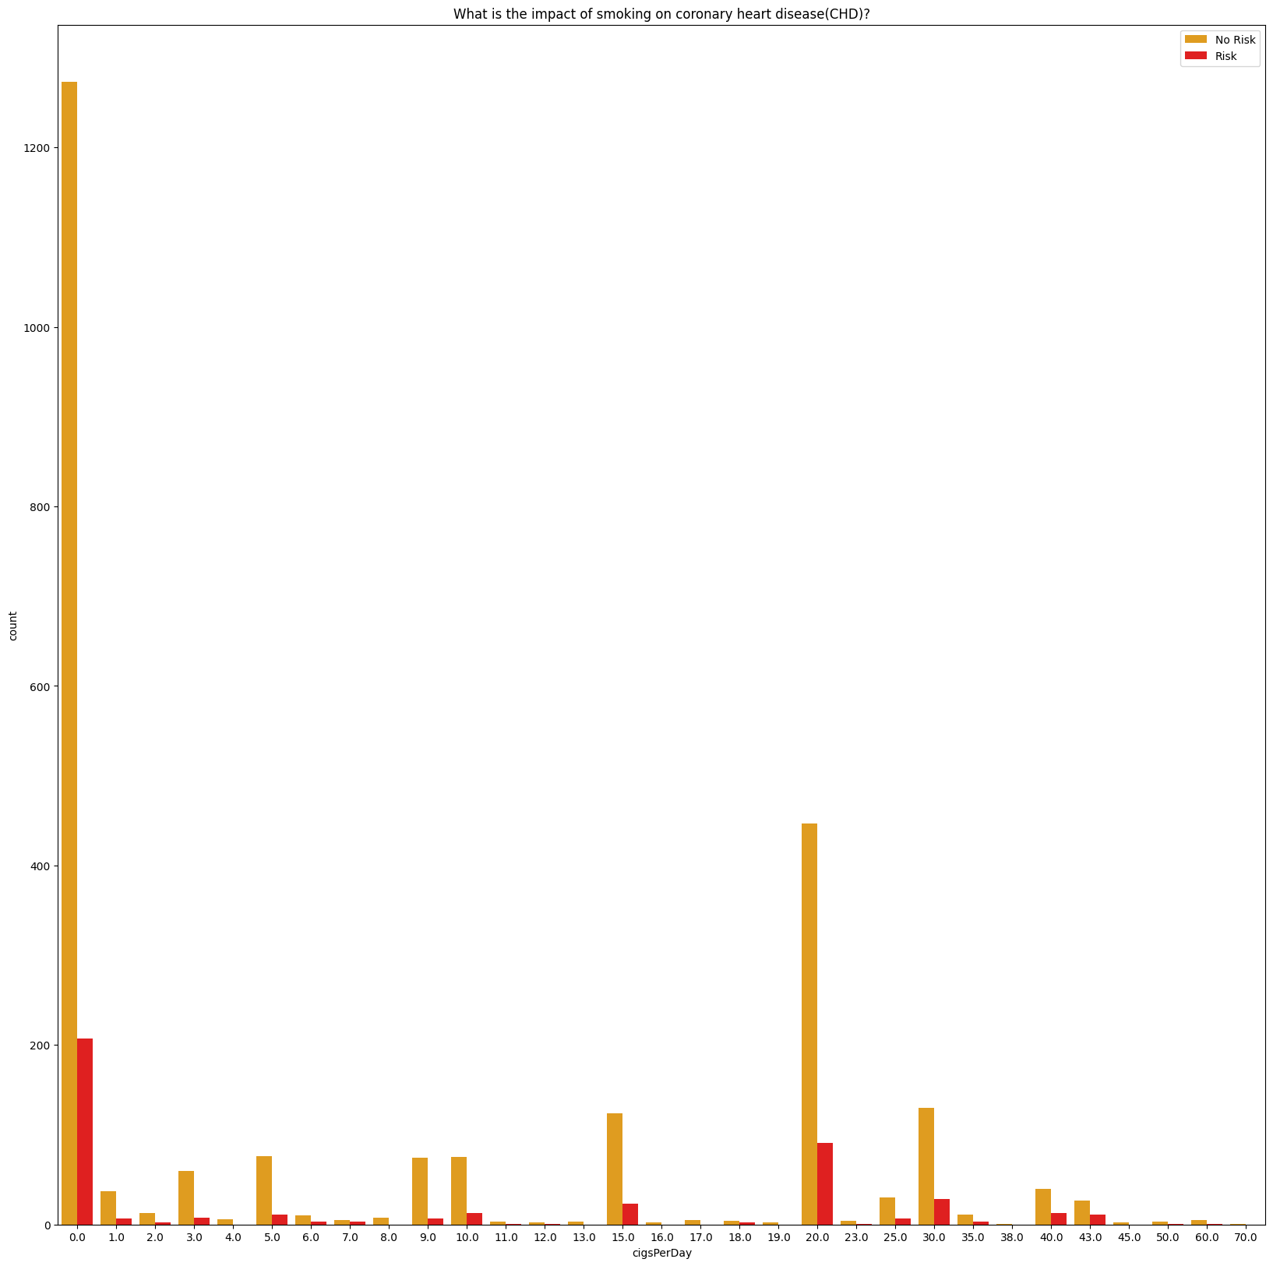
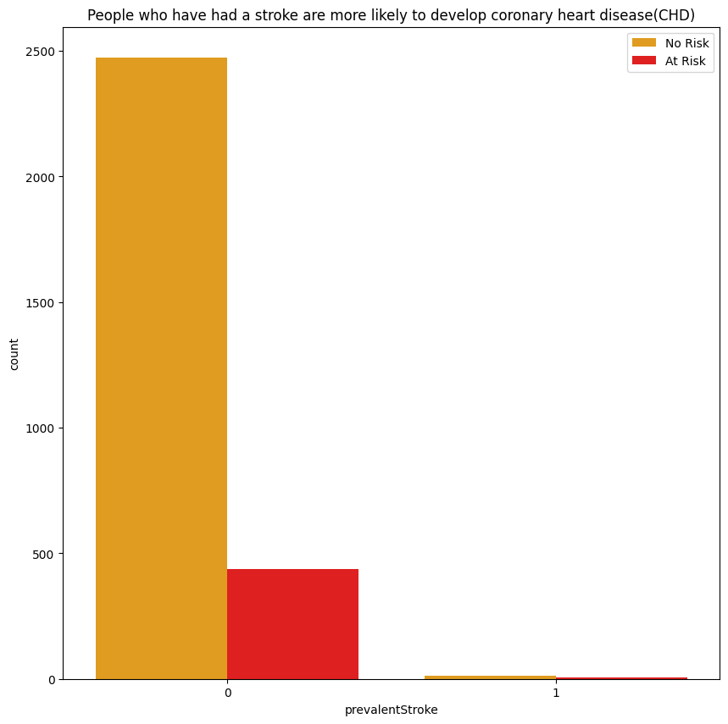
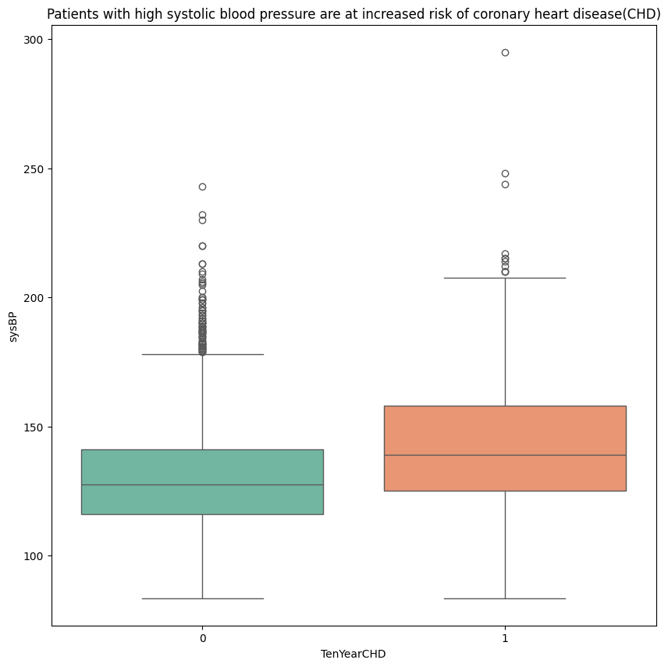
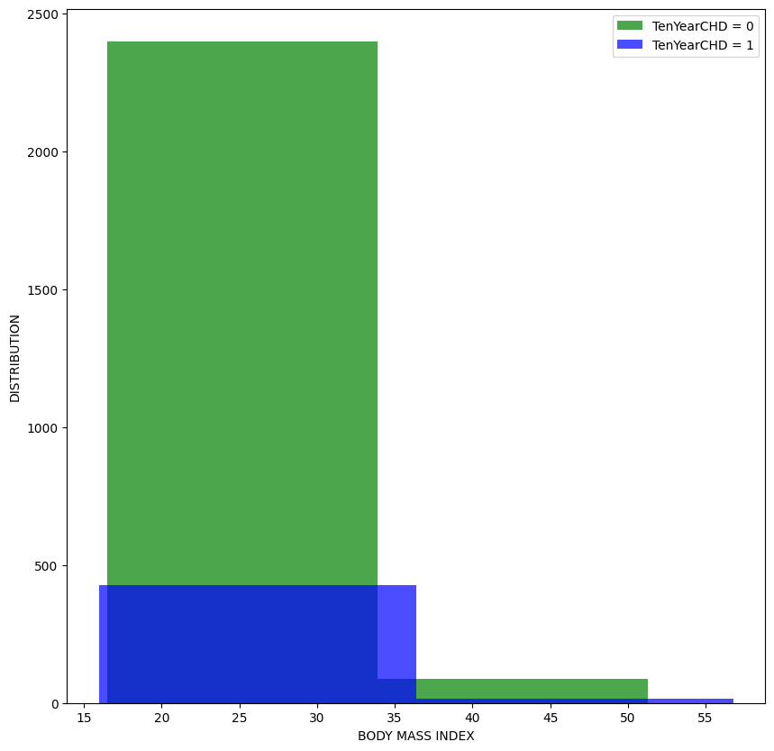
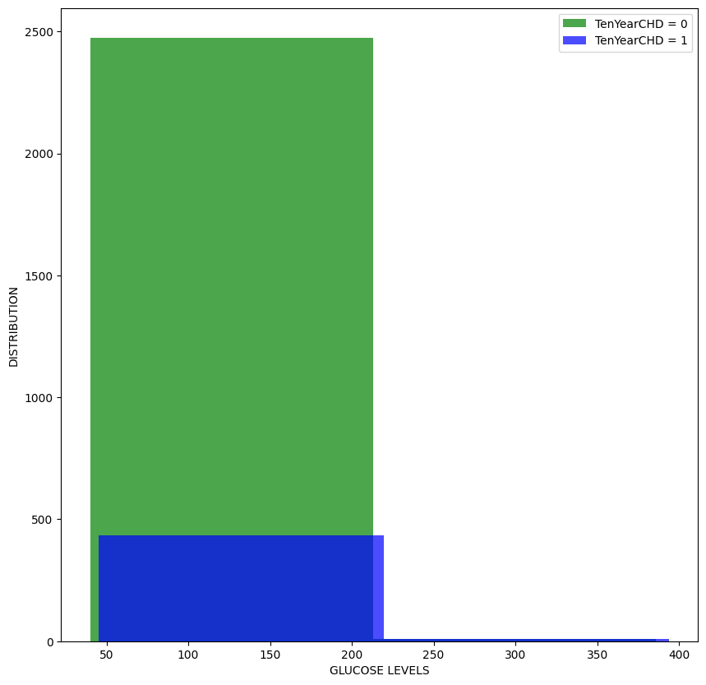

Slide 13
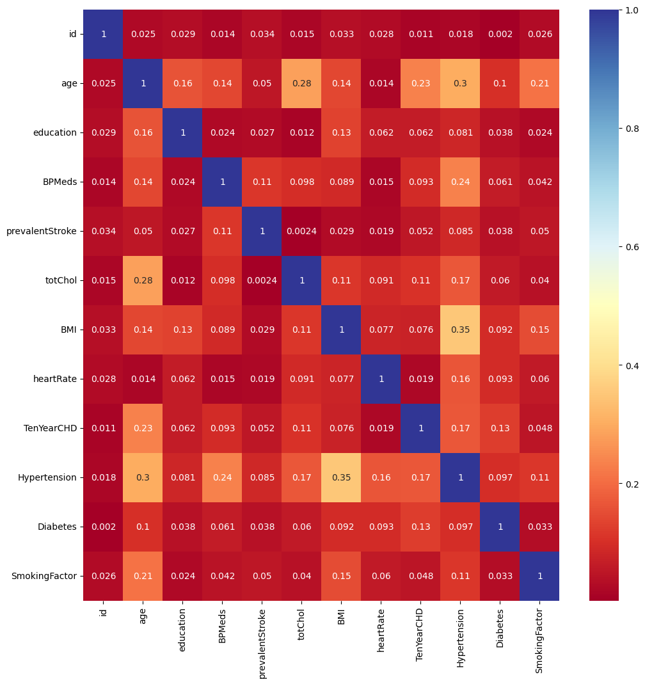
Correlation Analysis Heatmap

Slide 14
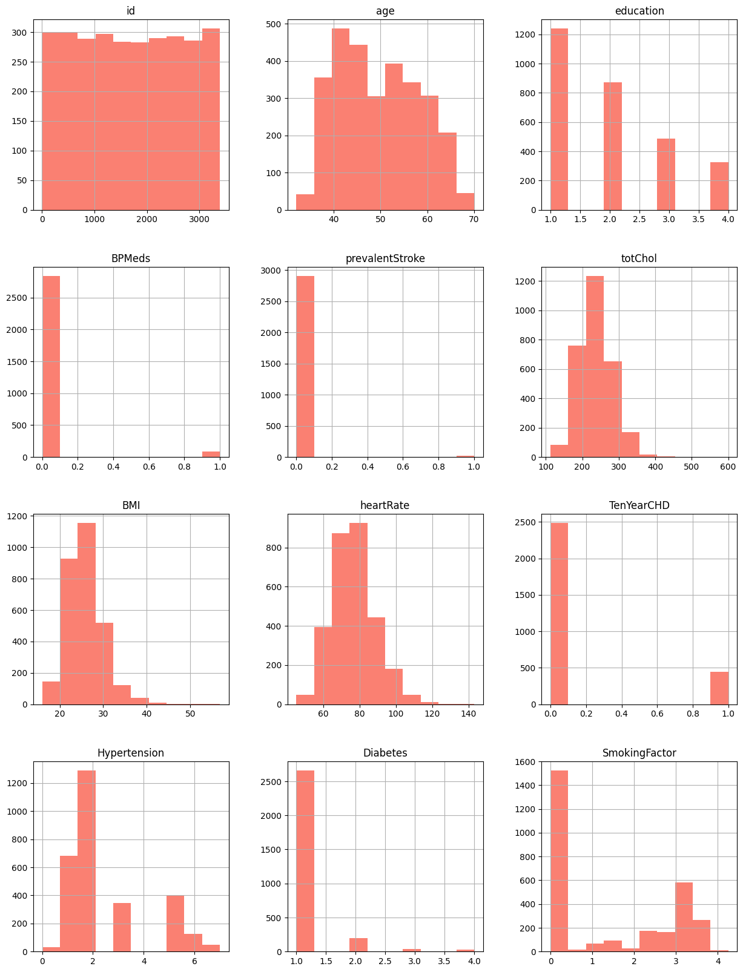
Histograms of Dataset Features

Slide 15
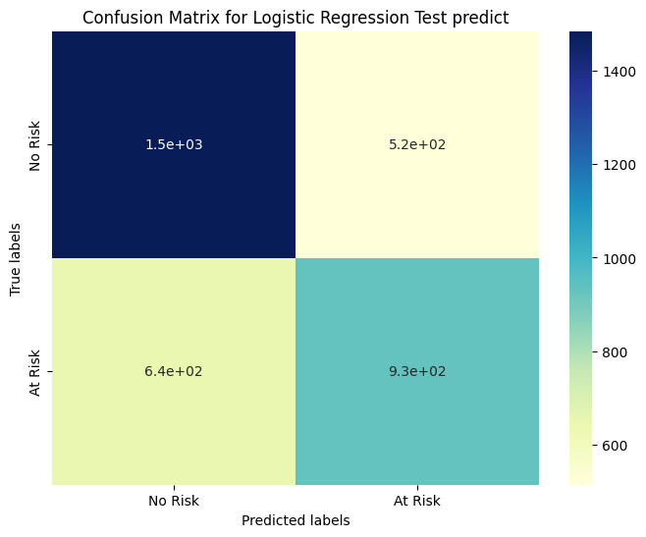
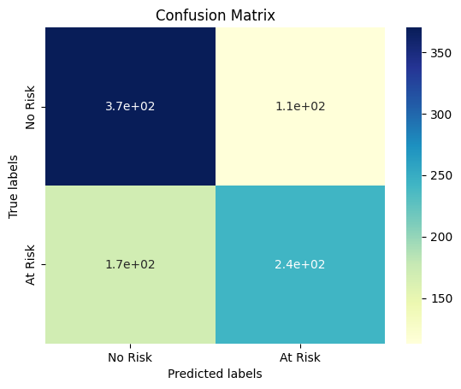
Confusion Matrix for Logistic Regression Predictions

Slide 16
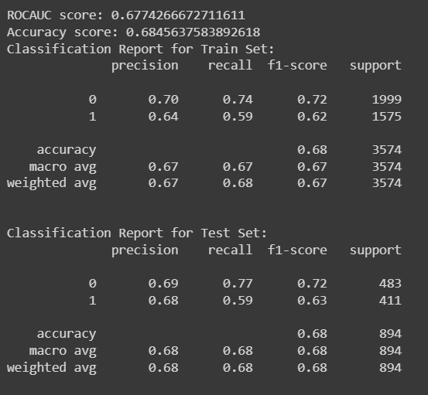
Performance Evaluation Metrics

Slide 17
Result
The machine learning model did a satisfactory job of predicting the risk of coronary heart disease (CHD) using the information that was made available. It demonstrated its effectiveness in distinguishing between individuals who are at low and high risk by achieving a ROC-AUC score of [insert ROC-AUC score] and an accuracy score of [insert accuracy score] on the test dataset. Additional performance evaluation of the model was conducted with the use of visual aids such as confusion matrices and classification reports. These visuals allowed for a comparison between expected and actual counts, highlighting the accuracy with which the algorithm classified individuals into various risk categories. The model may be used in clinical settings for early intervention and preventative measures because of its overall good accuracy and efficacy in identifying individuals at risk of congestive heart failure (CHD).

Slide 18
Conclusion
This project aimed to evaluate the 10-year risk of coronary heart disease (CHD) in patients using a classification task. The usage of frameworks like Pandas, Matplotlib, Seaborn, NumPy, and Scikit Learn allowed for efficient data analysis and visualization of CHD susceptibility. Nevertheless, problems include a deficiency of data, the omission of crucial elements like family history and the location of chest pain, and dataset imbalance limited the model's efficacy. Despite these obstacles, the study emphasizes the need of early CHD risk assessment and identifies areas that should be enhanced going forward to boost the prediction accuracy in clinical settings.

Slide 19
Future scope
In the future, we could improve this research by adding other details, such the location of the chest pain and any family history of CHD. Managing and increasing the size of the dataset can help improve the model's accuracy. Early therapies may be made possible by the use of advanced machine learning techniques and the model's incorporation into real-time monitoring systems or clinical decision support tools. To ensure validation and practical use, collaboration with healthcare providers is crucial. Initiatives to educate the public and get them involved in lowering their risk of CHD can also strengthen the model's impact on preventative healthcare.

Slide 20
References
For my project, I utilized Google to look into a number of libraries and data visualization strategies. I looked at other people's code in a couple of GitHub projects as well. Reading research papers helped me understand more about classifying and predicting data, which helped me better my project.

Slide 21
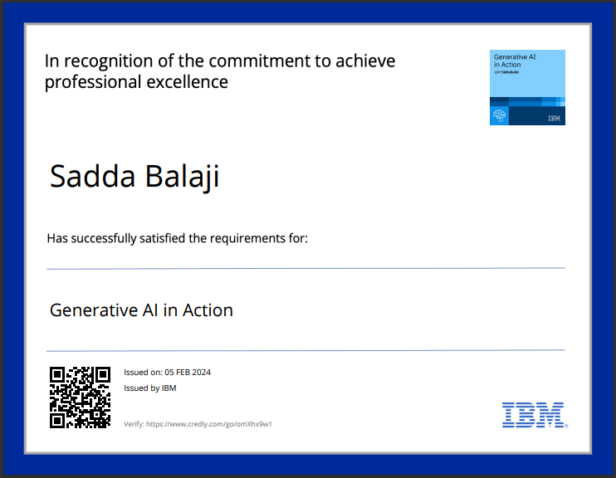
course certificate 1

Slide 22

course certificate 2

Slide 23
THANK YOU

